Slide 1

Week 1: SOC Setup & Log Ingestion
1-Technical Stack used
Operating System: Ubuntu 22.04 LTS
SIEM Engine: Elasticsearch 8.x
Visualization: Kibana
Log Collector: Elastic Agent

Slide 2
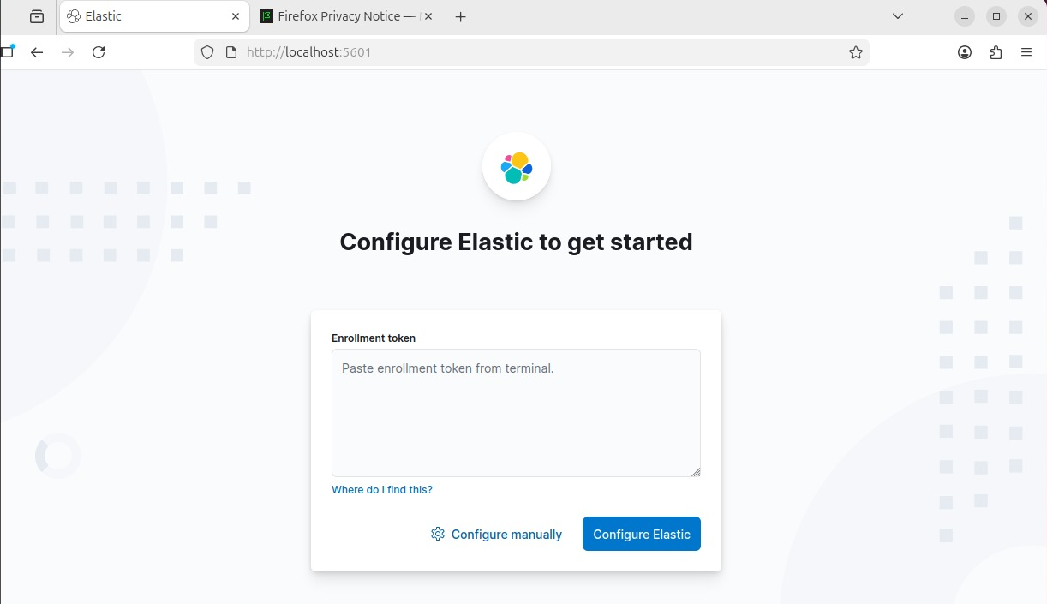
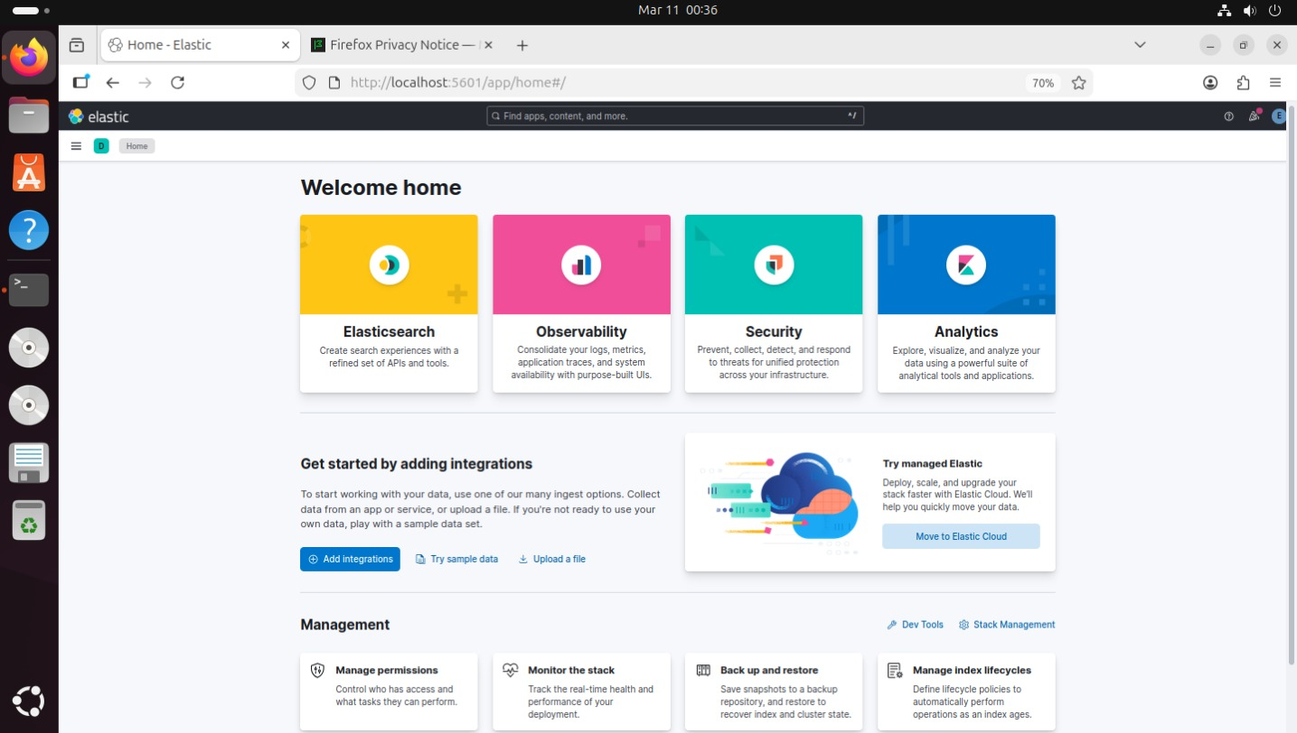
2-Implementation Phase
Step 1: Deploying the Elastic Stack
The ELK environment was set up and the security protocols (Role-based access control) were activated.
Username : elastic
Password : lEI2kcHY27G*wB9=mA1T

Slide 3

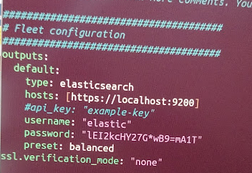
Step 2: Elastic Agent Configuration (The Challenge)
The Elastic Agent has been installed.
We found a problem
SSL Handshake (Error x509)
The problem was resolved by modifying the output configuration of the Elastic Agent .
Modify the elastic-agent.yml settings file (configuration) to link it to Elasticsearch.

Slide 4
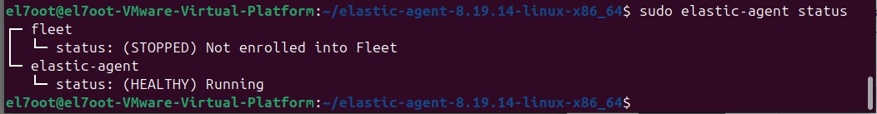
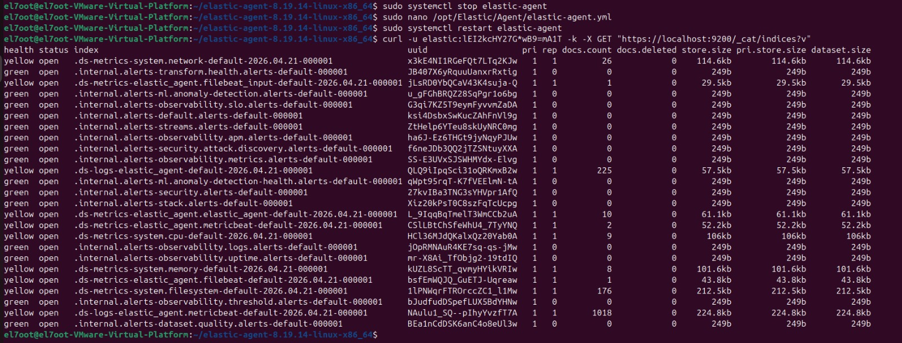
Step 3: Verification & Testing
Check that agent is running
Check that Elastic Agent can read my system log
>> curl -u elastic:lEI2kcHY27G*wB9=mA1T -k -X GET "https://localhost:9200/_cat/indices?v"

Slide 5
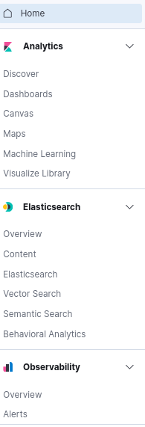
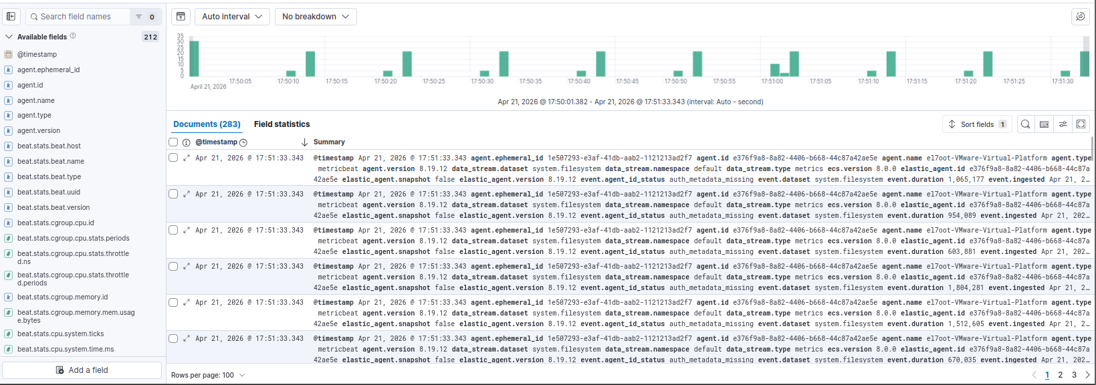
3-Dashboards & Visualization
# Discover

Slide 6
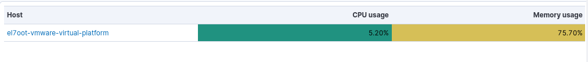
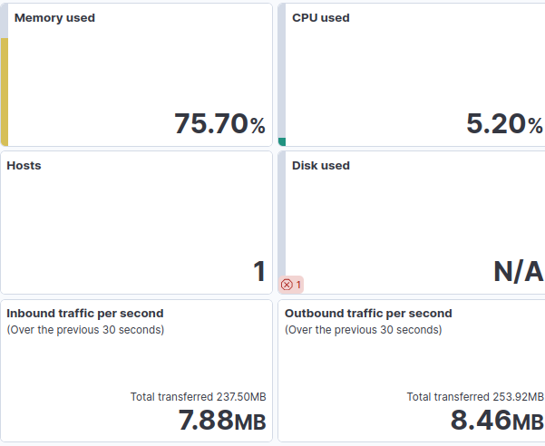
# System overview dashboard

